Slide 1
Lesson 91
Making graphs and solving equations of circles

Slide 2
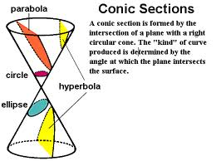
Conic Section

Slide 3
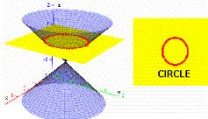
A Circle is formed by the intersection of a right cone and a plane that is perpendicular to the base

Slide 4
A circle is NOT a function
It does not pass the vertical line test

Slide 5
Distance formula = r =$\sqrt{{\left(x−0\right)}^{2}+{\left(y−0\right)}^{2} }$ or $r^{2}=x^{2}$+$y^{2 }$
If the center is at (0,0), then you can use the distance formula to find the radius

Slide 6
$x^{2}$+$y^{2}$=$r^{2}$
Equation of a circle with center (0,0) is

Slide 7
Graphing on a graphing calculator
The equation of a circle must be transformed into 2 functions in order to graph it on a graphing calculator
Isolate y and then enter the positive and negative square roots into the calculator as 2 functions, the graph them together to form a circle

Slide 8
Graphing circles centered at the origin
Graph $x^{2}+y^{2}=16$
$x^{2}+y^{2}$ =$4^{2}$ so radius is 4
Plot center at (0,0)
Plot the 4 points that are above, below, left and right of the center
Sketch the circle that passes through the 4 points

Slide 9
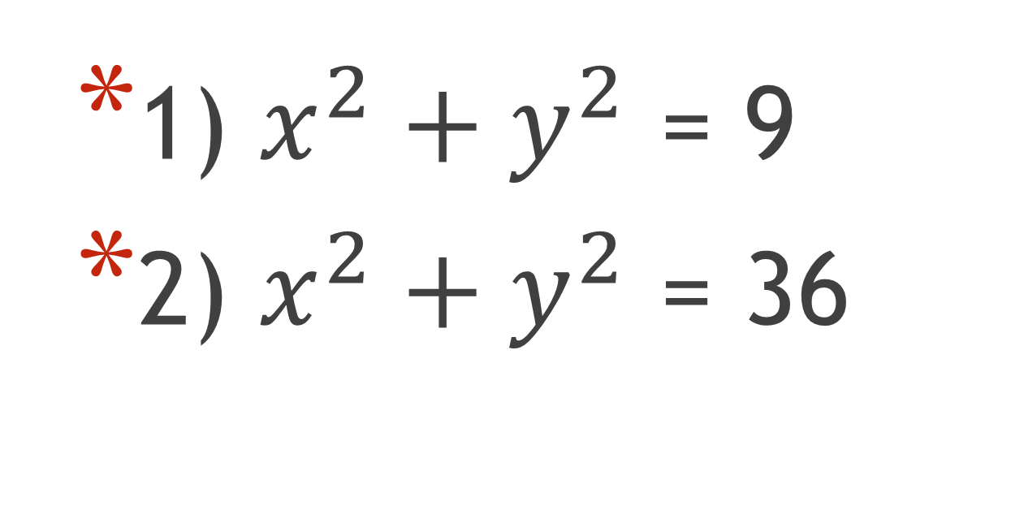
Sketch a graph
1) $x^{2}+y^{2}$ = 9
2) $x^{2}+y^{2}$ = 36

Slide 10
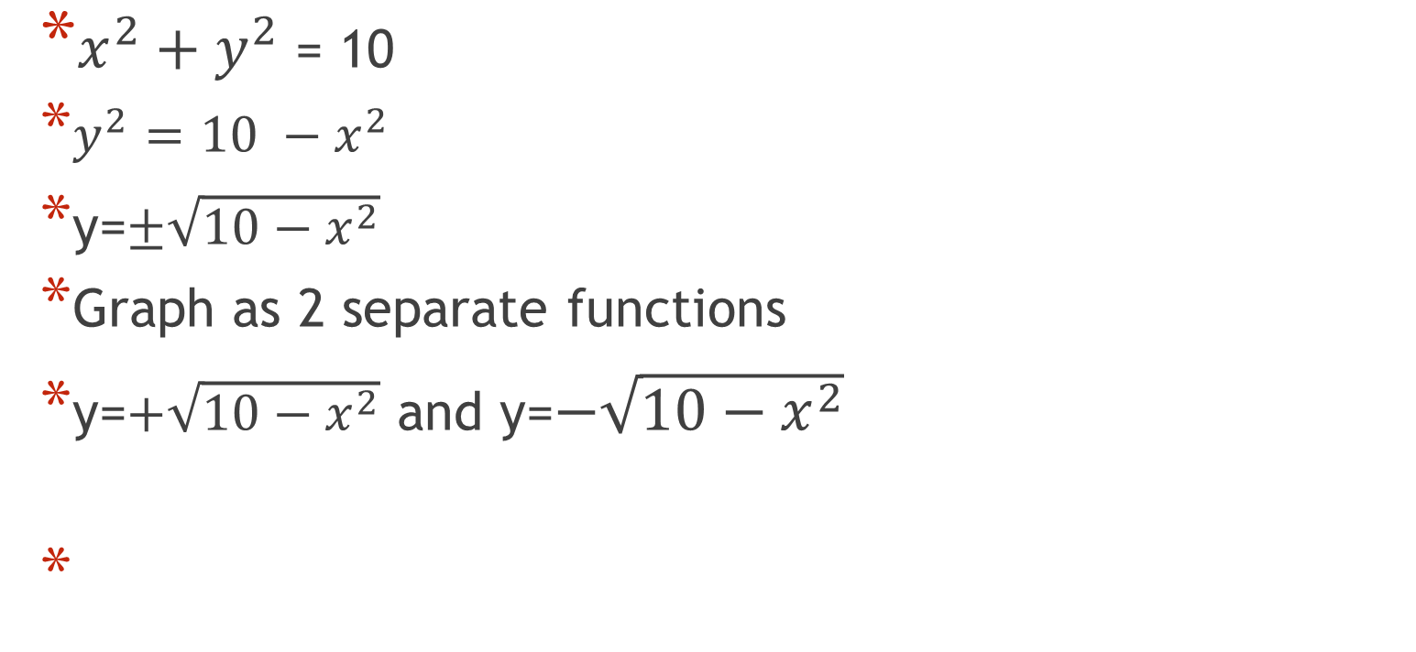
Graph- to keep the circle from looking distorted use ZOOM square
$x^{2}+y^{2}$ = 10
$y^{2}=10 −x^{2}$
y=$±\sqrt{10−x^{2}}$
Graph as 2 separate functions
y=$+\sqrt{10−x^{2}}$ and y=$−\sqrt{10−x^{2}}$

Slide 11
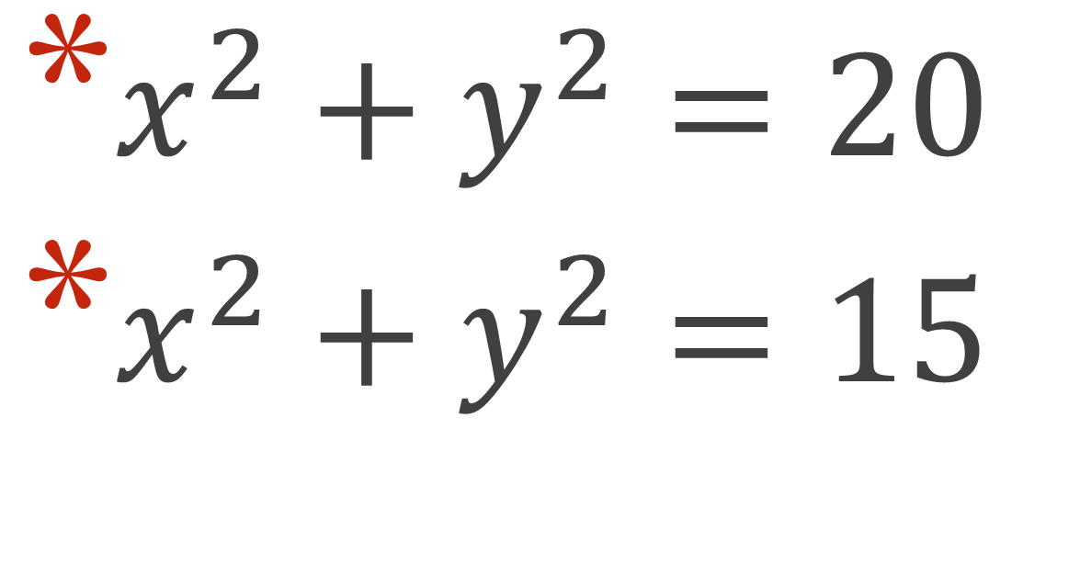
Graph on calculator
$x^{2}+y^{2}=20$
$x^{2}+y^{2}=15$

Slide 12
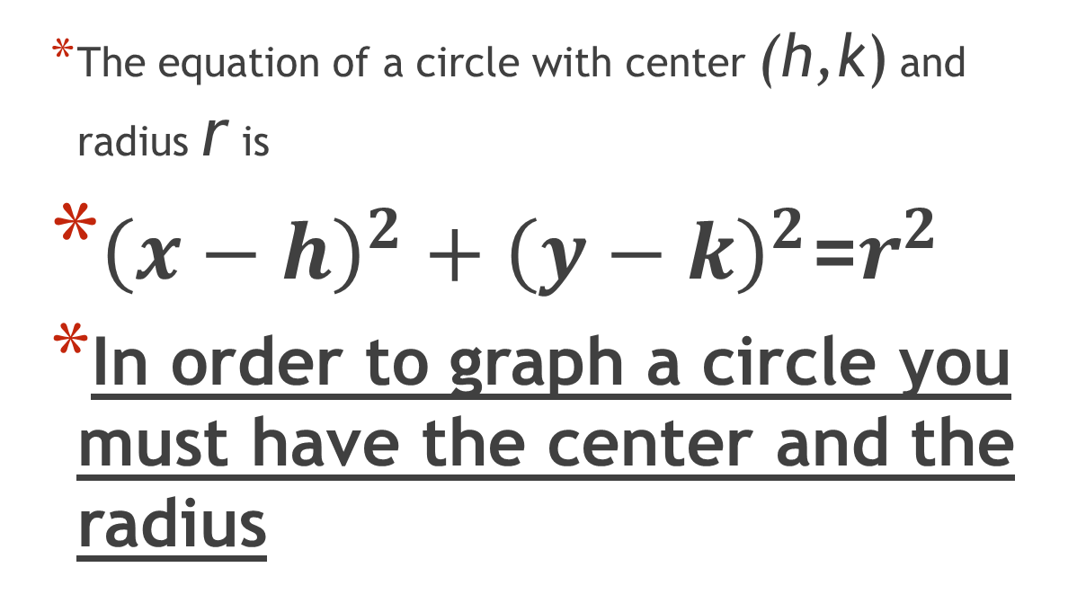
Standard form of an equation of a circle
The equation of a circle with center (h,k) and radius r is
${\left(x−h\right)}^{2}+{\left(y−k\right)}^{2}$=$r^{2}$
In order to graph a circle you must have the center and the radius

Slide 13
Graphing circles not centered at the origin
Sketch the graph of ${\left(x+2\right)}^{2}+{\left(y−1\right)}^{2}=9$
radius = 3 center = (-2,1)
Plot the center
plot the points 3 units above, below , left, and right of the center
Sketch the circle that goes through those points

Slide 14
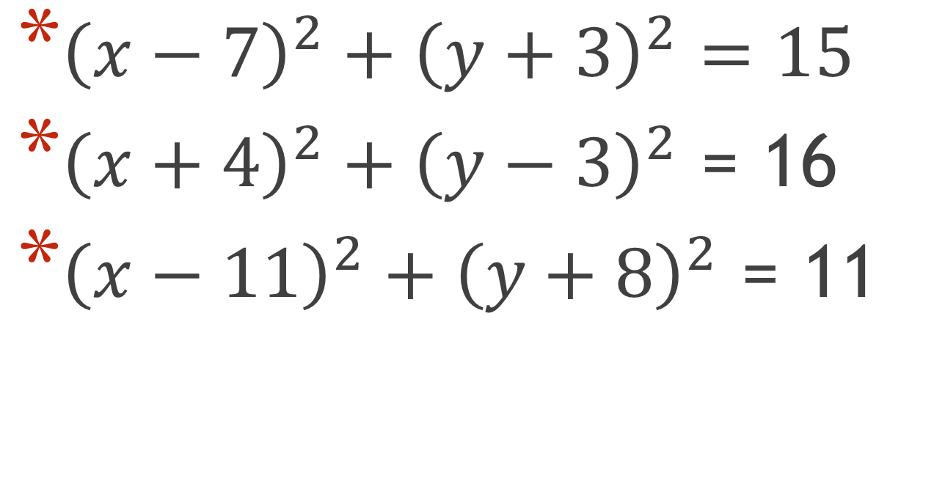
Graph on calculator
${\left(x−7\right)}^{2}+{\left(y+3\right)}^{2}=15$
${\left(x+4\right)}^{2}+{\left(y−3\right)}^{2}$ = 16
${\left(x−11\right)}^{2}+{\left(y+8\right)}^{2}$ = 11

Slide 15
Distance & midpoint formulas
Sometimes the center and radius are not explicitly given, so you might have to use the distance formula and/or the midpoint formula to find them.
$d=\sqrt{{\left(x_{2}−x_{1}\right)}^{2}+{\left(y_{2}−y_{1}\right)}^{2}}$
M = $\left(\frac{x_{1}+x_{2}}{2},\frac{y_{1}+y_{2}}{2}\right)$

Slide 16
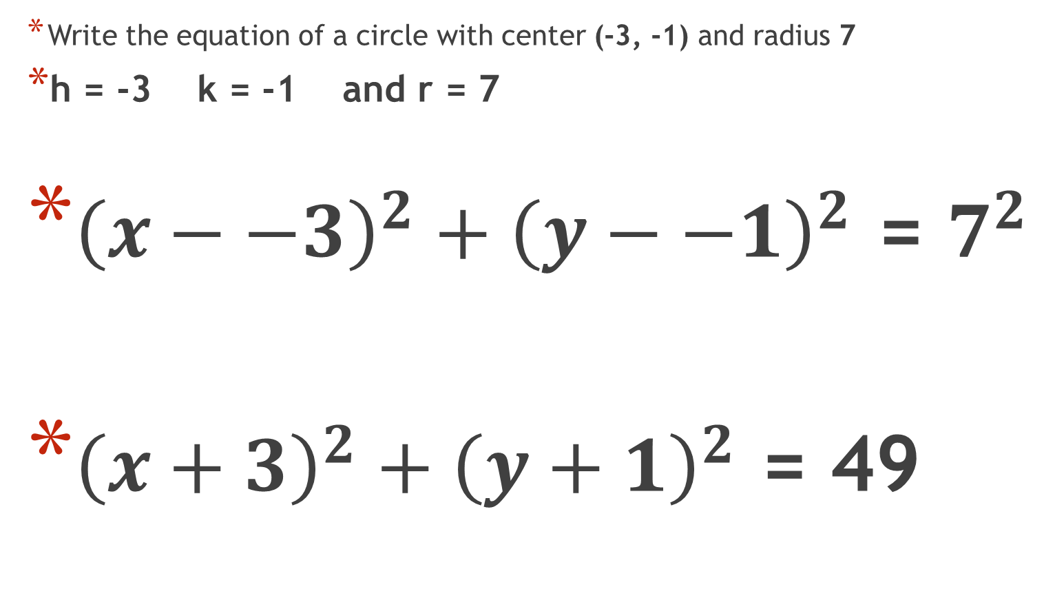
Writing the equation of a circle
Write the equation of a circle with center (-3, -1) and radius 7
h = -3 k = -1 and r = 7
${\left(x−−3\right)}^{2}+{\left(y−−1\right)}^{2}$ = $7^{2}$
${\left(x+3\right)}^{2}+{\left(y+1\right)}^{2}$ = 49

Slide 17
Write the equation of circles
Write the equation of the circle with center (-4,5) and radius 5

Slide 18
Write equation of circle
Write the equation of the circle with center at (-2,4) that contains the point (5,2)
Find the length of the radius by using the distance formula
r = $\sqrt{{\left(5−−2\right)}^{2}+{\left(2−4\right)}^{2}}$
r= $\sqrt{53}$
${\left(x−−2\right)}^{2}+{\left(y−4\right)}^{2}$ = ${\sqrt{53}}^{2}$
${\left(x+2\right)}^{2}+{\left(y−4\right)}^{2}$ = 53

Slide 19
Write equation of circle
Write equation of circle with center (3,-2) and that contains the point (-4,2)

Slide 20
Write equation of circle
Write the equation of the circle that has a diameter whose endpoints are located at (3,1) and (6,3)
Use the midpoint formula to find the center
M= $\left(\frac{x_{1}+x_{2}}{2},\frac{y_{1}+y_{2}}{2}\right)$ = $\left(\frac{3+6}{2},\frac{1+3}{2}\right)$ = ( 4.5, 2) = center
Find the distance between the center and either of the points on the circle
r= $\sqrt{{\left(3−4.5\right)}^{2}+{\left(1−2\right)}^{2}}$= $\sqrt{3.25}$
So ${\left(x−4.5\right)}^{2}+{\left(y−2\right)}^{2}$ =$3.25$

Slide 21
Write equation of circle
Write the equation of the circle that has a diameter whose endpoints are located at (7,5) and (3,3)

