Slide 1
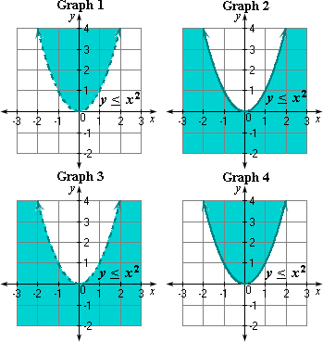
Solving Quadratic inequalities
Lesson 89

Slide 2
Quadratic inequality in 2 variables
A quadratic inequality in 2 variables is an inequality that can be written in the standard form of
y < a$x^{2}$ + bx + c, where a $≠$ 0 and < can be replaced by >, <, >

Slide 3
Graphing quadratic inequalities
The graph of a quadratic inequality divides the plane into a region that contains the solutions and a region that does not contain the solutions. The boundary is a parabola. The curve is dashed if it does not contain solutions ( <, >) and solid if it does contain solutions ( <, > )

Slide 4
graph
Y > -2$x^{2}$ + 12x – 16
1) graph y= -2$x^{2}$ + 12x – 16
2) find the vertex and its x-coordinate ( $\frac{−b}{2a}$ )
3) find the y-coordinate by substituting the x value into the equation
4) plot the vertex
5) plot the y-intercept
6)find the x- intercepts ( zeros)
7) shade above the parabola because it is >

Slide 5

graph
Y < 4$x^{2}$ - 2x - 6

Slide 6
Solving using a graphing calculator
$x^{2}$ - 3x - 7 < 3
Graph Y1 = $x^{2}$ - 3x - 7
and Y2 = 3
The solutions are those values for which the parabola is at or below the line y = 3
To find these x-values, find the points of intersection
X= -2 and x= 5
so -2 < x < 5 use Table function to check where Y1 < Y2

Slide 7

Use calculator to graph
$x^{2}$ + 10x + 22 > 6
$x^{2}$ + 8x + 16 < 4
$x^{2}$ - 7x + 14 > 4

Slide 8
Critical points
The 2 points of intersection are critical points.
They divide the graph into 3 regions

Slide 9
Solving quadratic inequalities Algebraically
Solve $x^{2}$ $x^{2}$+ x > 20
1) standard form $x^{2}$ + x -20 = 0
2) factor ( x+ 5)(x-4) =0
3) x= 4, -5 are critical values
4) test a point in all 3 regions , where x< -5
where-5<x<4
and where x>4
the 2 “outer” regions are solutions so x< -5 and x>4

Slide 10

Solve algebraically
$x^{2}$ -3x – 18 < 0
$x^{2}$ + 4x < 21
$x^{2}$ + 8x + 15 > 0

Slide 11
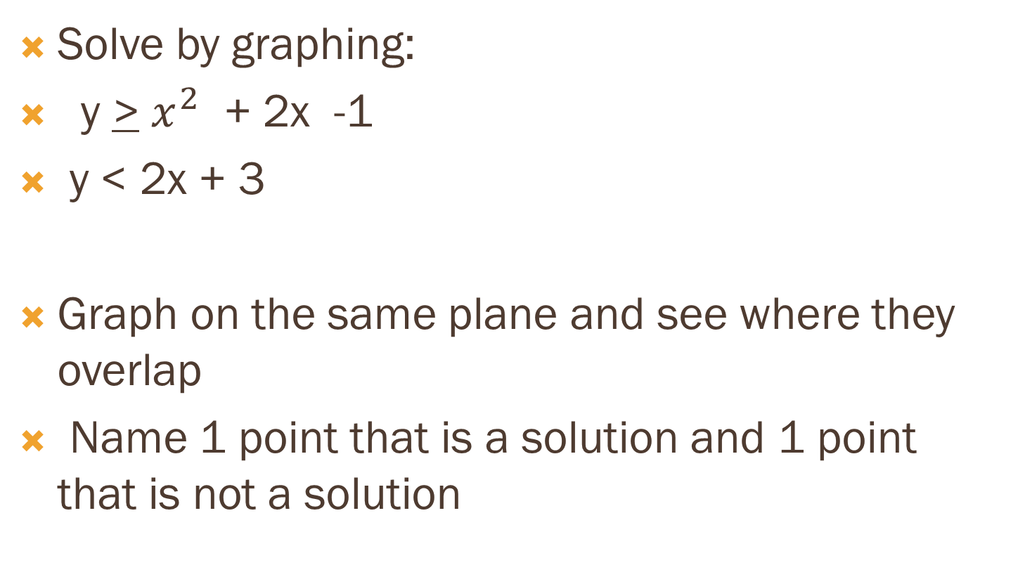
Solving systems that include quadratic inequalities
Solve by graphing:
y > $x^{2}$ + 2x -1
y < 2x + 3
Graph on the same plane and see where they overlap
Name 1 point that is a solution and 1 point that is not a solution

Slide 12

solve
y < $x^{2}$ + 4x + 3
y> x-2

